Slide 1
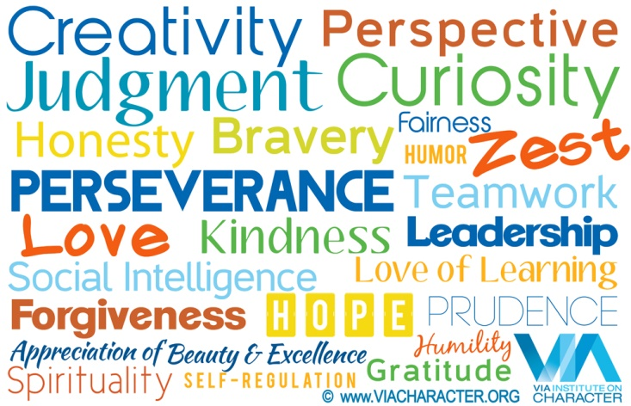
Personal Strengths

Slide 2
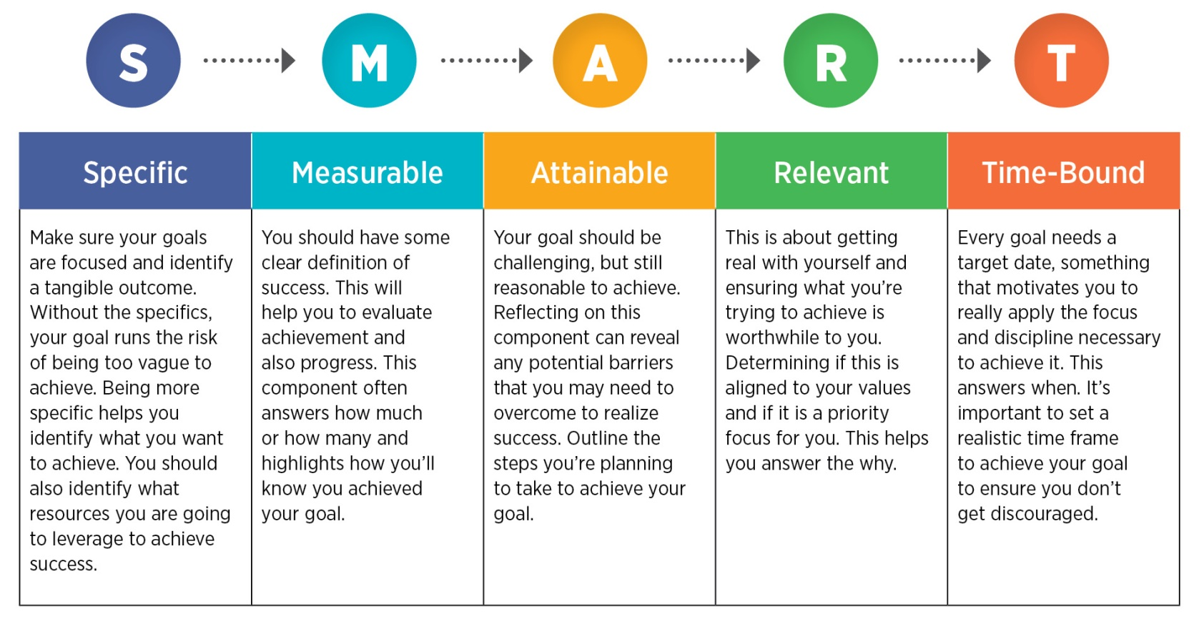

Slide 3
People tend to be happier and more satisfied in their lives when using their “strengths” on a regular basis.
Martin Seligman and Neal Mayerson, Ph.D., identifies 24 character strengths that all people have, with the recognition that some of these are more pronounced or developed in some vs. others.
The 24 character strengths are classified into 6 categories
Notes:
Categories in given in green colour headings
Personal strengths in red colour.

Slide 4
1. WISDOM
Wisdom deals with strengths that involve the way we acquire and use knowledge.
The quality of having experience, knowledge, and good judgement; the quality of being wise.

Slide 5

Creativity:
Creativity falls in the virtue category of Wisdom.
If Creativity is your top strength, thinking of new ways to do things is a crucial part of who you are.
You are never content with doing something the straight way if a better way is possible.
Wisdom deals with strengths that involve the way we acquire and use knowledge.
Key Concepts
There are two essential components to Creativity- originality and adaptiveness.
A creative individual generates ideas or behaviors that are novel or unusual and these make a positive contribution to the individual's life or the lives of others.
Creativity Motto: Do Things in a Different Way

Slide 6

Curiosity
If Curiosity is your top strength, you are interested in learning more about anything and everything.
You are always asking questions, and you find all subjects and topics fascinating.
You like exploration and discovery.
Key Concepts
There are two key components to curious individuals:
They are interested in exploring new ideas, activities and experiences, and they also have a strong desire to increase their own personal knowledge.
Curiosity Motto: Ask Questions, Lots of Them.

Slide 7

Judgment
If Judgment is your top strength, thinking things through and examining them from all sides are important aspects of who you are.
You do not jump to conclusions, and you rely only on solid evidence to make your decisions.
You are able to change your mind.

Slide 8
Key Concepts of Judgement:
The strength of judgment is a corrective strength in that it counteracts faulty thinking, such as favoring your current views or favoring ideas that are considered the dominant view, and therefore giving less attention to the less-dominant view.
It is the willingness to search actively for evidence against your favored beliefs, plans or goals and to weigh all of the evidence fairly when it is available.
Judgment Motto: Examine the details

Slide 9

Love Of Learning
If Love of Learning is your top strength, you love learning new things, whether in a class or on your own.
You have always loved school, reading, and museums-anywhere and everywhere there is an opportunity to learn.

Slide 10
Key Concepts
Love of learning describes the way in which a person engages new information and skills.
Love of learning is a strength that teachers would like to see in their students, parents want to encourage in their children, therapists support in their clients, and employers try to foster in their employees.
It has important motivational consequences because it helps people persist through challenges, setbacks and negative feedback.
Love of Learning Motto: Learn something from every situation

Slide 11

Perspective
If Perspective is your top strength, you have a way of
looking at the world that makes sense to others and to yourself.
Although you may not think of yourself as wise, your friends hold this view of you.
They value your perspective on matters and turn to you for advice.
Key Concepts
Perspective is distinct from intelligence but represents a high level of knowledge, the capacity to give advice and to recognize and weight multiple sides before making decisions.
It allows the individual to address important questions about the conduct and meaning of life.
Perspective Motto: Offer good advice.

Slide 12
2. COURAGE
Courage describes strengths that deal with overcoming fear.
These strengths can manifest themselves inwardly or outwardly as they are composed of cognitions, emotions, motivations and decisions.

Slide 13

Bravery:
Bravery falls under the virtue category of Courage.
If Bravery is your top strength, you are a courageous person who does not shrink from threat, challenge, difficulty, or pain.
You speak up for what is right even if there is opposition.
You act on your faith
Notes:
Bravery: without any feeling of fear.
Courage: Being brave even u r afraid.

Slide 14
Key Concepts
There are three types of bravery (an individual may possess one of these or a combination):
Physical bravery (e.g., firefighters, police officers, soldiers)
Psychological bravery (e.g., facing painful aspects of oneself)
Moral bravery (e.g., speaking up for what's right, even if it's an unfavorable opinion to a group
Bravery Motto
Face what you are afraid of

Slide 15

Honesty
If Honesty is your top strength, you are a straightforward person, not only by speaking the truth but by living your life
in a genuine and authentic way.
You are down to earth and without pretense; you are a "real" person.

Slide 16
Key Concepts
This strength involves accurately representing your internal states, intentions, and commitments, both publicly and privately.
The strength of honesty is often linked to self-concordance- the extent to which your goals accurately represent your implicit interests and values. Honesty allows people to take responsibility for their feelings and behaviors, owning them, and reaping benefits by doing so.
Honesty Motto: Tell people the truth, (almost) all the time

Slide 17

Perseverance:
If Perseverance is your top strength, you work hard to finish what you start. No matter the project,
you "get it out the door" in timely fashion. You do not get distracted when you work, and you take
satisfaction in completing tasks

Slide 18
Key Concepts
Perseverance involves the voluntary continuation of a goal-directed action despite the presence of challenges, difficulties, and discouragement. There are two vectors of perseverance. It requires both effort for a task and duration to keep the task up.
Perseverance Motto: Don't Give Up.

Slide 19

Zest:
If Zest is your top strength, you approach all experiences with excitement and energy.
You never do anything halfway or halfheartedly. For you, life is an adventure.
Key Concepts
Zest is a dynamic strengths that is directly related to physical and psychological wellness.
This strength has the strongest ties to overall life satisfaction and a life of engagement.
Zest Motto: When in doubt, take action!

